Slide 1
Python for Data Analysis

Slide 2
Tutorial Content
Overview of Python Libraries for Data Scientists
Pandas: Reading Data; Selecting and Filtering the Data; Data manipulation, sorting, grouping, rearranging
Matplotlib, Seaborn: Plotting the data
Descriptive statistics
Inferential statistics

Slide 3
Python Libraries for Data Science
Many popular Python toolboxes/libraries:
NumPy: NumPy is used for working with arrays
SciPy: scientific computation library that uses NumPy underneath
Pandas: Pandas is an open-source data analysis and manipulation tool
SciKit-Learn (sklearn): Popular machine learning library in Python that provides simple and efficient tools for data mining, data analysis, and machine learning. It is built on top of NumPy, SciPy, and Matplotlib
Visualization libraries
matplotlib
Seaborn
and many more …

Slide 4

Python Libraries for Data Science
NumPy:
introduces objects for multidimensional arrays and matrices, as well as functions that allow to easily perform advanced mathematical and statistical operations on those objects
provides vectorization of mathematical operations on arrays and matrices which significantly improves the performance
many other python libraries are built on NumPy
Link: http://www.numpy.org/

Slide 5

Python Libraries for Data Science
SciPy:
collection of algorithms for linear algebra, differential equations, numerical integration, optimization, statistics and more
part of SciPy Stack
built on NumPy
Link: https://www.scipy.org/scipylib/

Slide 6
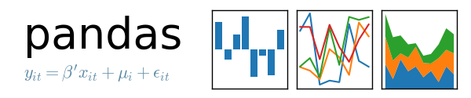
Python Libraries for Data Science
Pandas:
adds data structures and tools designed to work with table-like data (similar to Series and Data Frames in R)
provides tools for data manipulation: reshaping, merging, sorting, slicing, aggregation etc.
allows handling duplicate and missing data: Preprocessing Dataset
Link: http://pandas.pydata.org/

Slide 7

Python Libraries for Data Science
SciKit-Learn:
provides machine learning algorithms: classification, regression, clustering, model validation etc.
built on NumPy, SciPy and matplotlib
Link: http://scikit-learn.org/

Slide 8

Python Libraries for Data Science
matplotlib:
Python 2D plotting library which produces publication quality figures in a variety of hardcopy formats
a set of functionalities similar to those of MATLAB
line plots, scatter plots, barcharts, histograms, pie charts, etc.
relatively low-level; some effort needed to create advanced visualization
Link: https://matplotlib.org/

Slide 9
Python Libraries for Data Science
Seaborn:
based on matplotlib
provides high level interface for drawing attractive statistical graphics
Similar (in style) to the popular ggplot2 library in R
Link: https://seaborn.pydata.org/

Slide 10
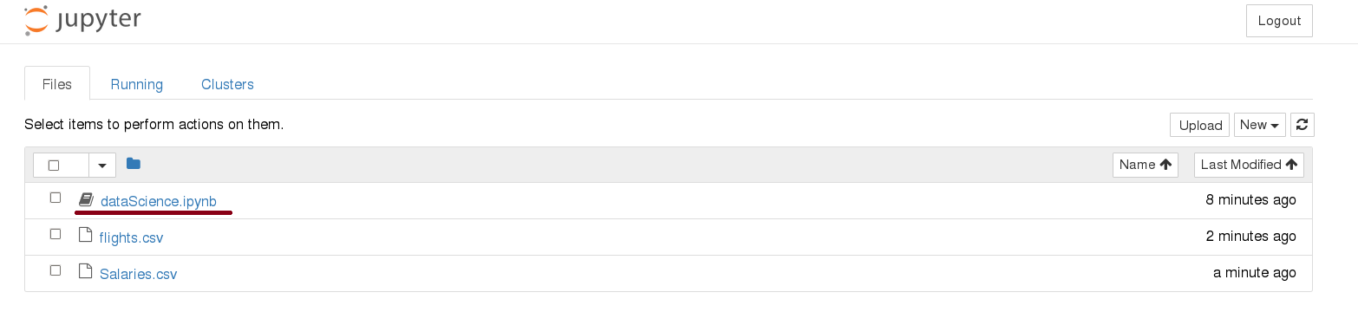
Start Jupyter notebook
# On the Shared Computing Cluster
[scc1 ~] Jupyter notebook
Interactive Python Notebook: ipynb

Slide 11
Loading Python Libraries
In [ ]:
#Import Python Libraries
import numpy as np
import scipy as sp
import pandas as pd
import matplotlib as mpl
from matplotlib import pyplot as plt
import seaborn as sns
Press Shift+Enter to execute the Jupyter cell

Slide 12
Reading data using pandas
In [ ]:
#Read csv file
df = pd.read_csv("http://rcs.bu.edu/examples/python/data_analysis/Salaries.csv")
Read a CSV (Comma-Separated Values) file into a DataFrame
Note: The above command has many optional arguments to fine-tune the data import process.
There is a number of pandas commands to read other data formats:
pd.read_excel('myfile.xlsx',sheet_name='Sheet1', index_col=None, na_values=['NA'])
pd.read_stata('myfile.dta')
pd.read_sas('myfile.sas7bdat')
pd.read_hdf('myfile.h5','df’)
DataFrame is a 2-dimensional, tabular data structure provided by the Pandas library. It's similar to a table in a database or an Excel spreadsheet where data is organized in rows and columns

Slide 13
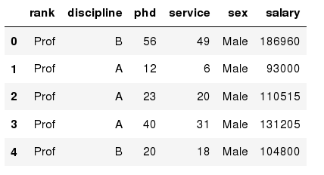
Exploring data frames
In [3]:
#List first 5 records
df.head()
Out[3]:

Slide 14

Hands-on exercises
Try to read the first 10, 20, 50 records;
Can you guess how to view the last few records; Hint:

Slide 15
Data Frame data types
Pandas Type | Native Python Type | Description
object | string | The most general dtype. Will be assigned to your column if column has mixed types (numbers and strings).
int64 | int | Numeric characters. 64 refers to the memory allocated to hold this character.
float64 | float | Numeric characters with decimals. If a column contains numbers and NaNs(see below), pandas will default to float64, in case your missing value has a decimal.
datetime64, timedelta[ns] | N/A (but see the datetime module in Python’s standard library) | Values meant to hold time data. Look into these for time series experiments.

Slide 16
Data Frame data types
In [4]:
#Check a particular column type
df['salary'].dtype # creating a list
Out[4]: dtype('int64')
In [5]:
#Check types for all the columns
df.dtypes
Out[4]:
object
object
int64
int64
object
int64
rank
discipline
phd
service
sex
salary
dtype: object

Slide 17
Data Frames attributes
Python objects have attributes and methods/functions.
df.describe () # methods/function
df.columns # attributes of the dataset
Python methods/functions have parenthesis.
Python attributes have NO parenthesis.
df.attribute | description
dtypes | list the types of the columns
columns | list the column names
axes | list the row labels and column names
ndim | number of dimensions
size | number of elements
shape | return a tuple representing the dimensionality
values | numpy representation of the data

Slide 18
Mid/Final Questions
Find how many records/instances/samples this data frame has; df.shape[0]
How many elements are there? df.size
What are the column names? df.columns
What data types of columns we have in this data frame? df.dtypes

Slide 19
Data Frames methods/functions
Unlike attributes, Python methods/functions have parenthesis.
All attributes and methods can be listed with a dir() function: dir(df)
df.method() | description
head( [n] ), tail( [n] ) | Print first/last n rows
describe() | generate descriptive statistics (for numeric columns only)
max(), min() | return max/min values for all numeric columns
mean(), median() | return mean/median values for all numeric columns
std() | standard deviation
sample([n]) | returns a random sample of the data frame
dropna() | drop all the records with missing values

Slide 20
Mid/Final Questions
Give the summary for the numeric columns in the dataset: df.describe()
Calculate standard deviation for all numeric columns; df.std()
What are the mean values of the first 50 records in the dataset? Hint: use head() method to subset the first 50 records and then calculate the mean
df.head(50).mean()

Slide 21
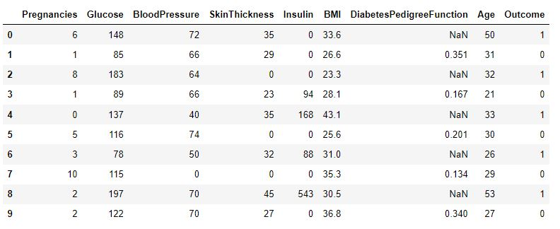





Handle missing/ null values: Data Cleaning
In Pandas, usually, missing values are represented by NaN. It stands for Not a Number
df.isnull().sum() function is used in Pandas to check for missing values (NaN values) in a DataFrame. It returns the count of missing values in each column

Slide 22



Handle missing/ null values: Data Cleaning
Deleting the column with missing data: Used for many features.
If columns have more than half of the rows as null, then the entire column can be dropped. The rows which are having one or more columns values as null can also be dropped
2. Deleting the row with missing data: Used for large dataset
The rows which are having one or more columns values as null can also be dropped.
Loss of a lot of information.
Works poorly if the percentage of missing values is excessive in comparison to the complete dataset
If the proportion of missing observations in data is small relative to the total number of observations, we can simply remove those observations.
Deleting the rows containing missing values may lead to parting away with useful information or patterns

Slide 23
Handle missing/ null values: Data Cleaning
Imputation is a technique used for replacing the missing data with some substitute value to retain most of the data/information of the dataset
Works well with a small dataset and is easy to implement
3. Filling the Missing Values with mean, median, mode
4. Filling with a Regression/Classification Model
5. Filling with unsupervised/clustering technique

Slide 24
Handle missing/ null values: KNNImputer
Imputation for completing missing values using k-Nearest Neighbors ML algorithm
Each sample’s missing values are imputed using the mean value from n_neighbors nearest neighbors found in the training set.
from sklearn.impute import KNNImputer
# create an object for KNNImputer with default hyperparameters
imputer = KNNImputer()
df2 = imputer.fit_transform(df)

Slide 25
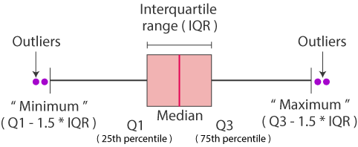
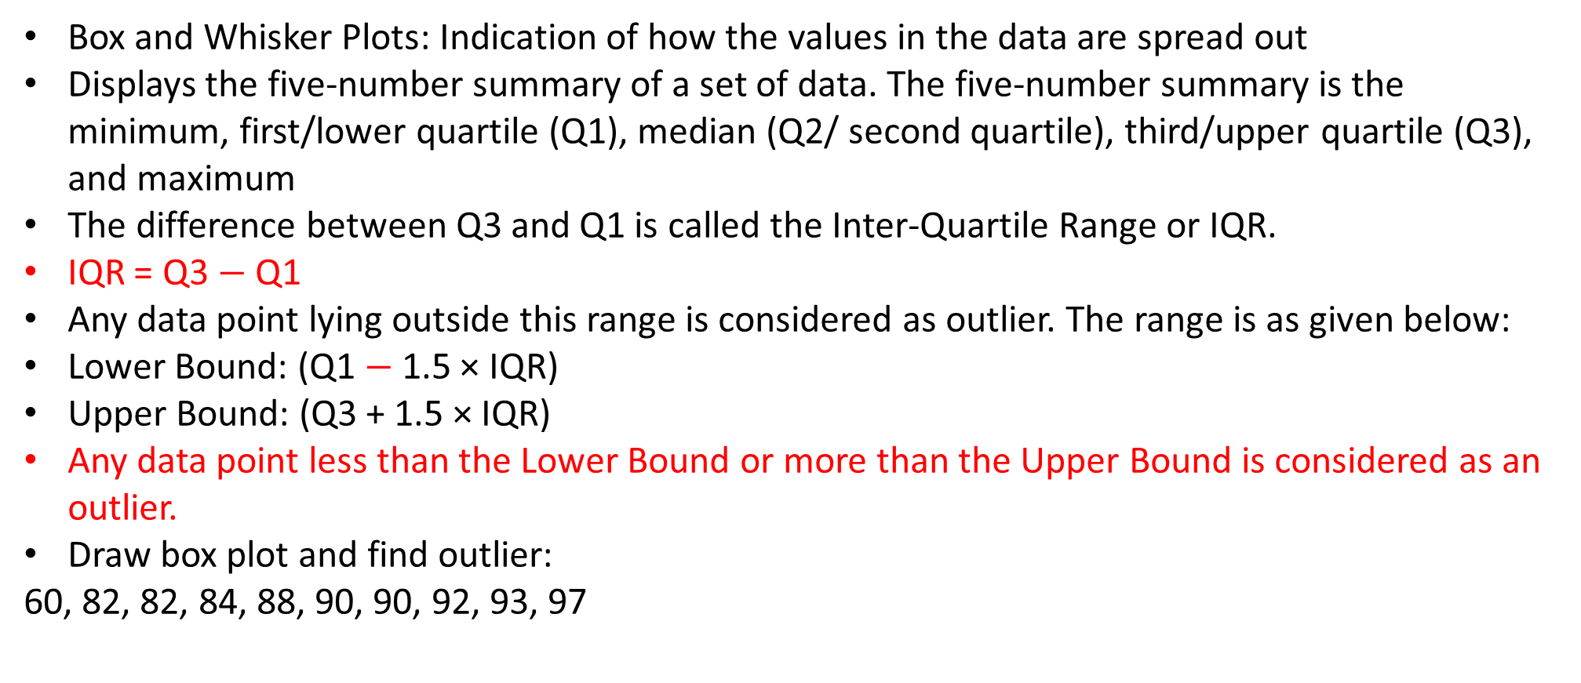
Box and Whisker Plots: Outlier Detection
Box and Whisker Plots: Indication of how the values in the data are spread out
Displays the five-number summary of a set of data. The five-number summary is the minimum, first/lower quartile (Q1), median (Q2/ second quartile), third/upper quartile (Q3), and maximum
The difference between Q3 and Q1 is called the Inter-Quartile Range or IQR.
IQR = Q3 $−$ Q1
Any data point lying outside this range is considered as outlier. The range is as given below:
Lower Bound: (Q1 $−$ 1.5 × IQR)
Upper Bound: (Q3 + 1.5 × IQR)
Any data point less than the Lower Bound or more than the Upper Bound is considered as an outlier.
Draw box plot and find outlier:
60, 82, 82, 84, 88, 90, 90, 92, 93, 97

Slide 26
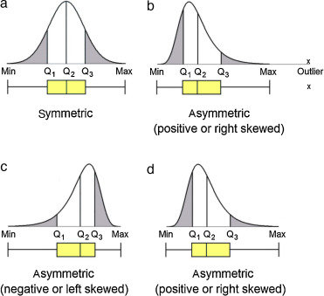
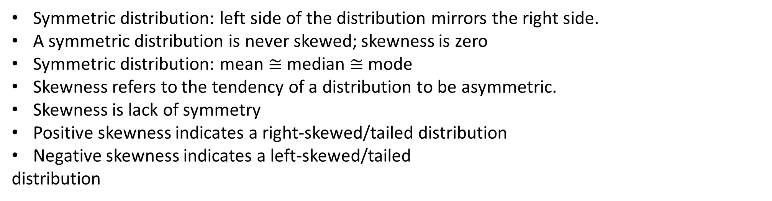
Box Plot: Skewness
Symmetric distribution: left side of the distribution mirrors the right side.
A symmetric distribution is never skewed; skewness is zero
Symmetric distribution: mean $≅$ median $≅$ mode
Skewness refers to the tendency of a distribution to be asymmetric.
Skewness is lack of symmetry
Positive skewness indicates a right-skewed/tailed distribution
Negative skewness indicates a left-skewed/tailed
distribution

Slide 27
Detecting and Treating Outliers
Outliers are those data points which differs significantly from other observations present in given dataset
An outlier may occur due to the variability in the data, or due to experimental/human error
Deleting observations: Trimming/ Removing the Outliers
Log Transforming values
Mean/median Imputation
Quantile based flooring and capping: In this technique, the outlier is capped at a certain value above the 90th percentile value or floored at a factor below the 10th percentile value. The data points that are less than the 10th percentile are placed with the 10th percentile value, and the data points that are greater than the 90th percentile are replaced with the 90th percentile value

Slide 28
Selecting a column in a Data Frame
Method 1: Subset the data frame using column name:
df[‘Age']
Method 2: Use the column name as an attribute:
df.Age
Note: there is an attribute rank for pandas data frames, so to select a column with a name "rank" we should use method 1.

Slide 29
Hands-on exercises
Calculate the basic statistics for the salary column;
Find how many values in the salary column (use count method);
Calculate the average salary;

Slide 30
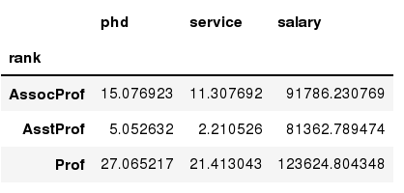
Data Frames groupby method
Using "group by" method we can:
Split the data into groups based on some criteria
Calculate statistics (or apply a function) to each group
Similar to dplyr() function in R
In [ ]:
#Group data using rank
df_rank = df.groupby(['rank'])
In [ ]:
#Calculate mean value for each numeric column per each group
df_rank.mean()

Slide 31
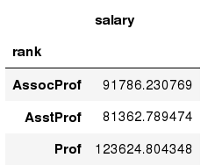
Data Frames groupby method
Once groupby object is create we can calculate various statistics for each group:
In [ ]:
#Calculate mean salary for each professor rank:
df.groupby('rank')[['salary']].mean()
Note: If single brackets are used to specify the column (e.g. salary), then the output is Pandas Series object. When double brackets are used the output is a Data Frame

Slide 32
Data Frames groupby method
groupby performance notes:
- no grouping/splitting occurs until it's needed. Creating the groupby object only verifies that you have passed a valid mapping
- by default the group keys are sorted during the groupby operation. You may want to pass sort=False for potential speedup:
In [ ]:
#Calculate mean salary for each professor rank:
df.groupby(['rank'], sort=False)[['salary']].mean()

Slide 33
Data Frame: filtering
To subset the data we can apply Boolean indexing. This indexing is commonly known as a filter. For example if we want to subset the rows in which the salary value is greater than $120K:
In [ ]:
#Calculate mean salary for each professor rank:
df_sub = df[ df['salary'] > 120000 ]
Any Boolean operator can be used to subset the data:
> greater; >= greater or equal;
< less; <= less or equal;
== equal; != not equal;
In [ ]:
#Select only those rows that contain female professors:
df_f = df[ df['sex'] == 'Female' ]

Slide 34
Data Frames: Slicing
There are a number of ways to subset the Data Frame:
one or more columns
one or more rows
a subset of rows and columns
Rows and columns can be selected by their position or label

Slide 35
Data Frames: Slicing
When selecting one column, it is possible to use single set of brackets, but the resulting object will be a Series (not a DataFrame):
In [ ]:
#Select column salary:
df['salary']
When we need to select more than one column and/or make the output to be a DataFrame, we should use double brackets:
In [ ]:
#Select column salary:
df[['rank','salary']]

Slide 36
Data Frames: Selecting rows
If we need to select a range of rows, we can specify the range using ":"
In [ ]:
#Select rows by their position:
df[10:20]
Notice that the first row has a position 0, and the last value in the range is omitted:
So for 0:10 range the first 10 rows are returned with the positions starting with 0 and ending with 9

Slide 37
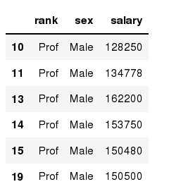
Data Frames: method loc
If we need to select a range of rows, using their labels we can use method loc:
In [ ]:
#Select rows by their labels:
df_sub.loc[10:20,['rank','sex','salary']]
Out[ ]:

Slide 38
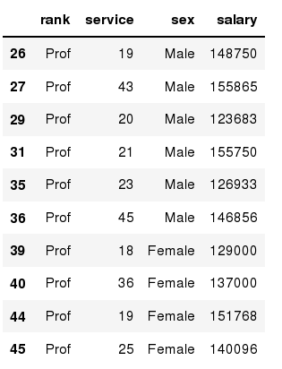
Data Frames: method iloc
If we need to select a range of rows and/or columns, using their positions we can use method iloc:
In [ ]:
#Select rows by their labels:
df_sub.iloc[10:20,[0, 3, 4, 5]]
Out[ ]:

Slide 39
Data Frames: method iloc (summary)
df.iloc[0] # First row of a data frame
df.iloc[i] #(i+1)th row
df.iloc[-1] # Last row
df.iloc[:, 0] # First column
df.iloc[:, -1] # Last column
df.iloc[0:7] #First 7 rows
df.iloc[:, 0:2] #First 2 columns
df.iloc[1:3, 0:2] #Second through third rows and first 2 columns
df.iloc[[0,5], [1,3]] #1st and 6th rows and 2nd and 4th columns

Slide 40
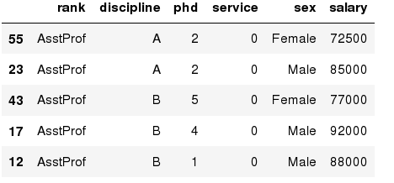
Data Frames: Sorting
We can sort the data by a value in the column. By default the sorting will occur in ascending order and a new data frame is return.
In [ ]:
# Create a new data frame from the original sorted by the column Salary
df_sorted = df.sort_values( by ='service')
df_sorted.head()
Out[ ]:

Slide 41
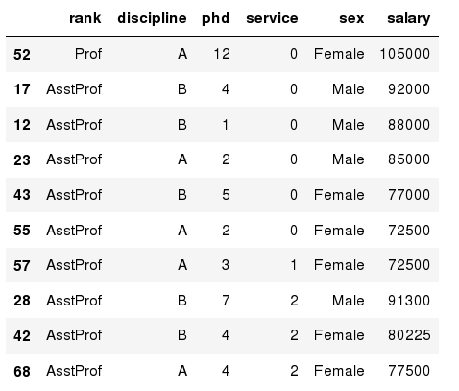
Data Frames: Sorting
We can sort the data using 2 or more columns:
In [ ]:
df_sorted = df.sort_values( by =['service', 'salary'], ascending = [True, False])
df_sorted.head(10)
Out[ ]:

Slide 42
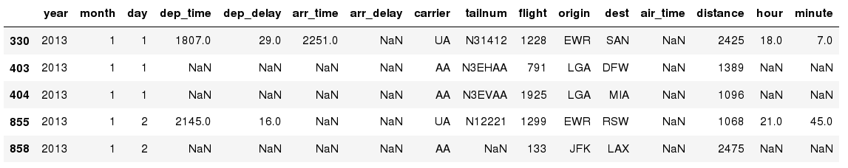
Missing Values
Missing values are marked as NaN
In [ ]:
# Read a dataset with missing values
flights = pd.read_csv("http://rcs.bu.edu/examples/python/data_analysis/flights.csv")
In [ ]:
# Select the rows that have at least one missing value
flights[flights.isnull().any(axis=1)].head()
Out[ ]:

Slide 43
Missing Values
There are a number of methods to deal with missing values in the data frame:
df.method() | description
dropna() | Drop missing observations
dropna(how='all') | Drop observations where all cells is NA
dropna(axis=1, how='all') | Drop column if all the values are missing
dropna(thresh = 5) | Drop rows that contain less than 5 non-missing values
fillna(0) | Replace missing values with zeros
isnull() | returns True if the value is missing
notnull() | Returns True for non-missing values

Slide 44
Missing Values
When summing the data, missing values will be treated as zero
If all values are missing, the sum will be equal to NaN
cumsum() and cumprod() methods ignore missing values but preserve them in the resulting arrays
Missing values in GroupBy method are excluded (just like in R)
Many descriptive statistics methods have skipna option to control if missing data should be excluded . This value is set to True by default (unlike R)

Slide 45
Aggregation Functions in Pandas
Aggregation - computing a summary statistic about each group, i.e.
compute group sums or means
compute group sizes/counts
Common aggregation functions:
min, max
count, sum, prod
mean, median, mode, mad
std, var

Slide 46
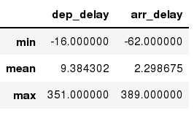
Aggregation Functions in Pandas
agg() method are useful when multiple statistics are computed per column:
In [ ]:
flights[['dep_delay','arr_delay']].agg(['min','mean','max'])
Out[ ]:

Slide 47
Basic Descriptive Statistics
df.method() | description
describe | Basic statistics (count, mean, std, min, quantiles, max)
min, max | Minimum and maximum values
mean, median, mode | Arithmetic average, median and mode
var, std | Variance and standard deviation
sem | Standard error of mean
skew | Sample skewness
kurt | kurtosis

Slide 48
Graphics to explore the data
Seaborn package is built on matplotlib but provides high level interface for drawing attractive statistical graphics, similar to ggplot2 library in R. It specifically targets statistical data visualization
To show graphs within Python notebook include inline directive:
In [ ]:
%matplotlib inline

Slide 49
Graphics
 | description
distplot | histogram
barplot | estimate of central tendency for a numeric variable
violinplot | similar to boxplot, also shows the probability density of the data
jointplot | Scatterplot
regplot | Regression plot
pairplot | Pairplot
boxplot | boxplot
swarmplot | categorical scatterplot
factorplot | General categorical plot

